Slide 1
ECE Lab Kit Organization
© S.J.Bitar – Educational Services
Modified with permission by K. Ferreira – ECE Department
2009 – 2014

Slide 2
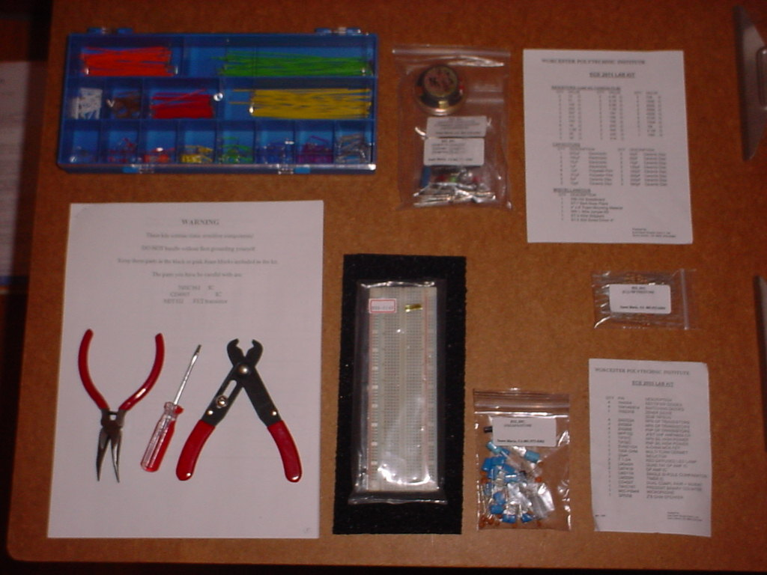
ECE Lab Kit
Old Version with Screwdriver

Slide 3
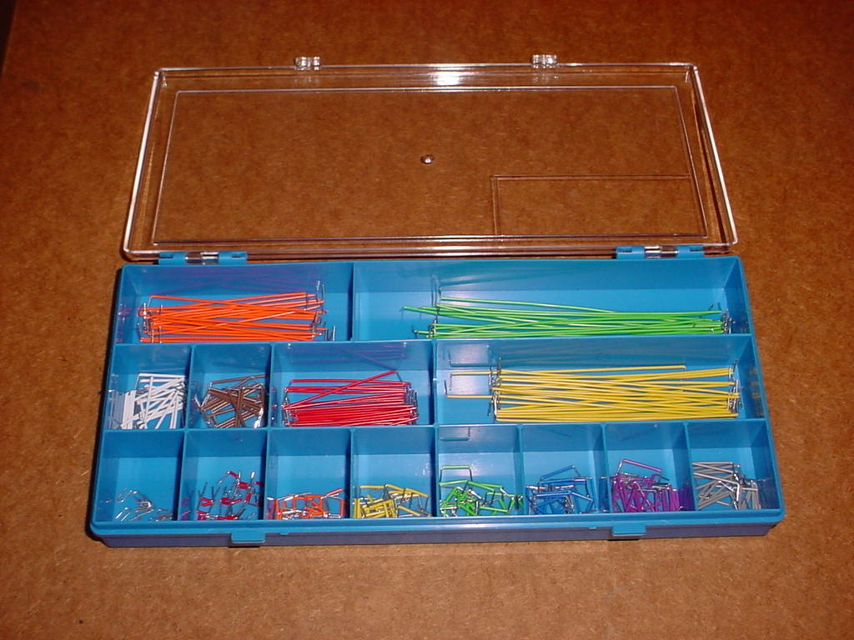
Wires

Slide 4
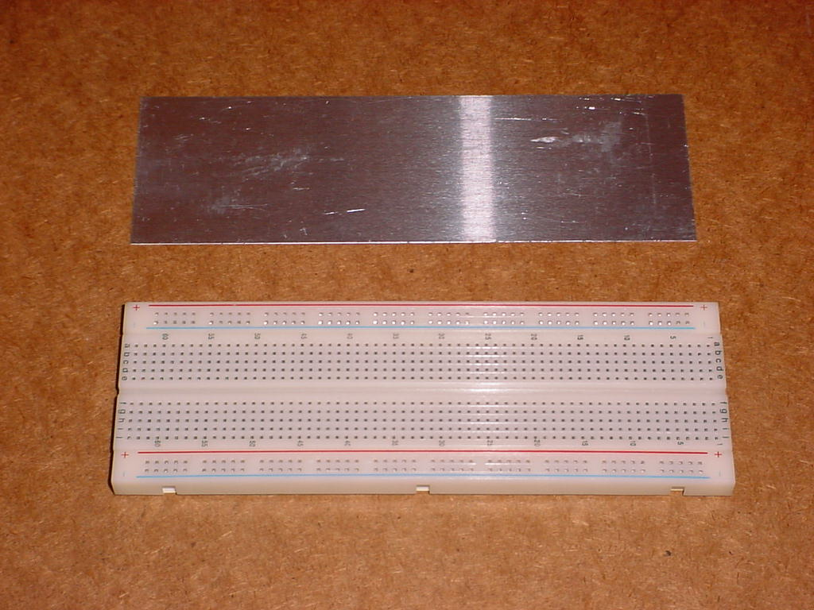
Breadboard and Plate

Slide 5
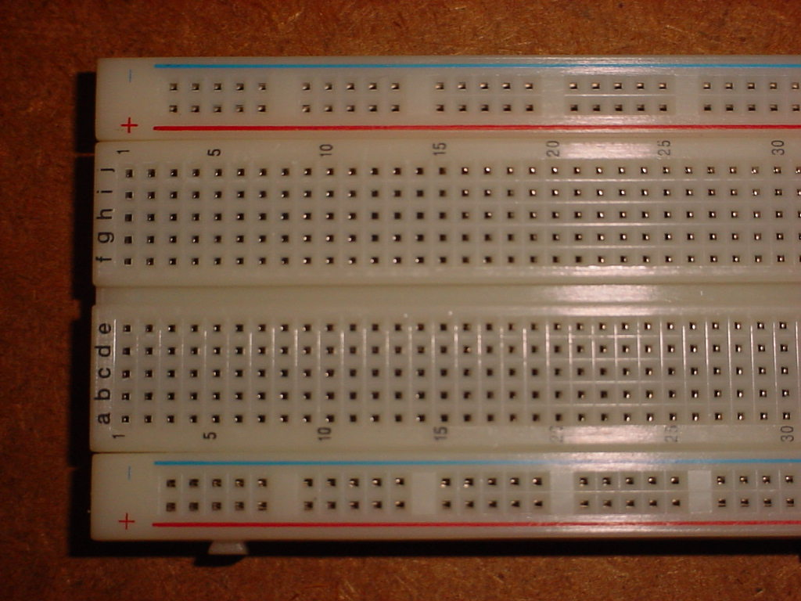
Breadboard Close-Up

Slide 6
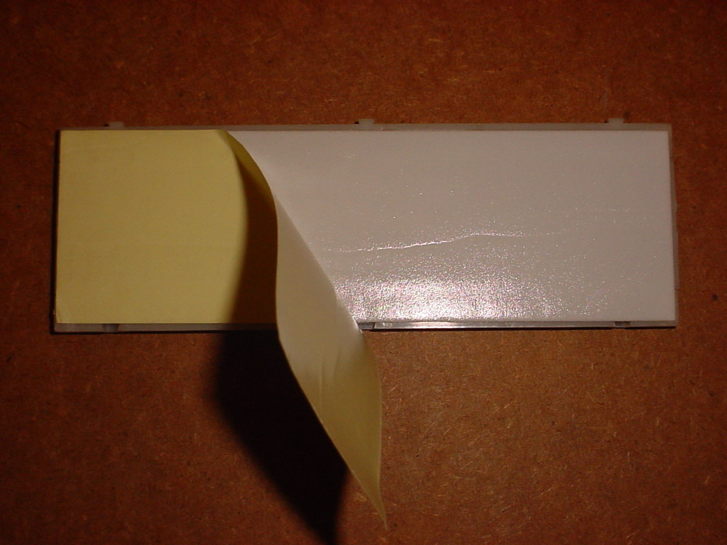
Adhesive Backing

Slide 7
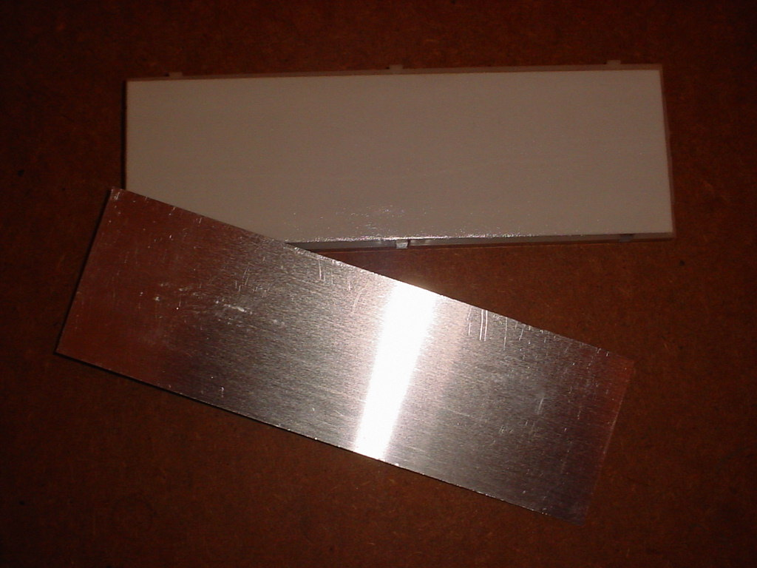
Plate Location

Slide 8
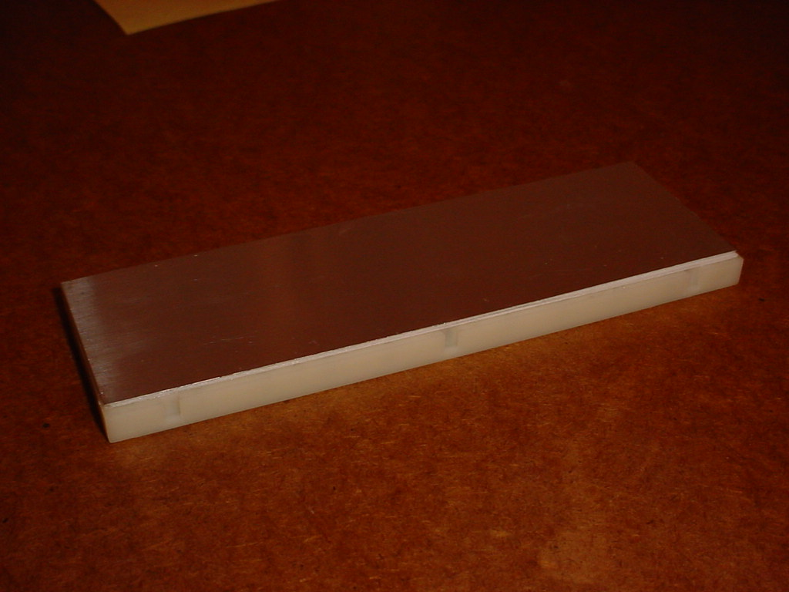
Plate Applied

Slide 9
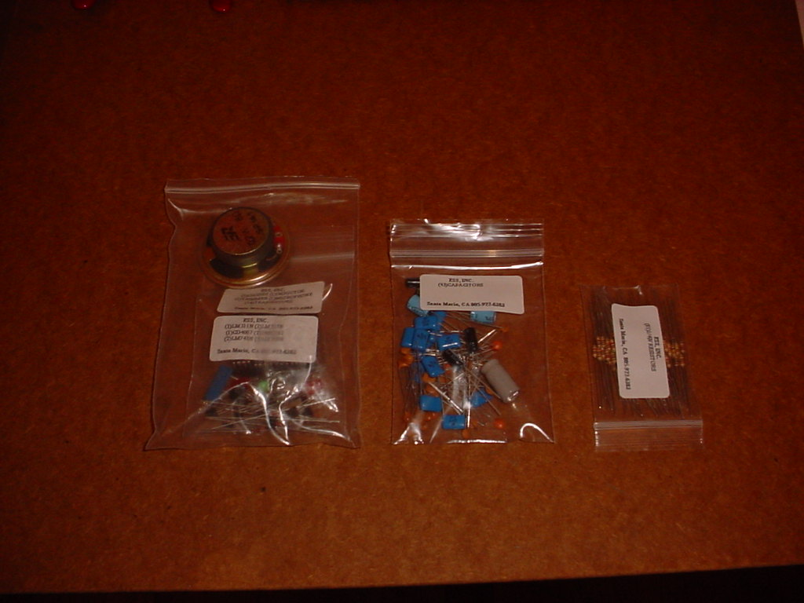
Components

Slide 10
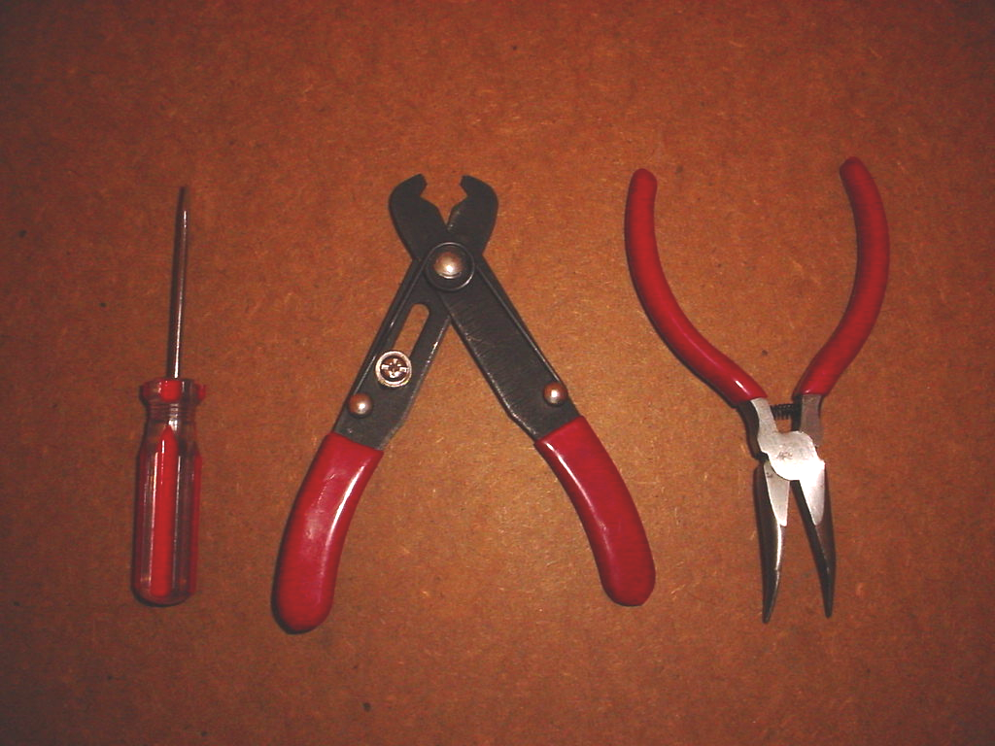
Tools
Again, New Kits Have No Screwdriver

Slide 11
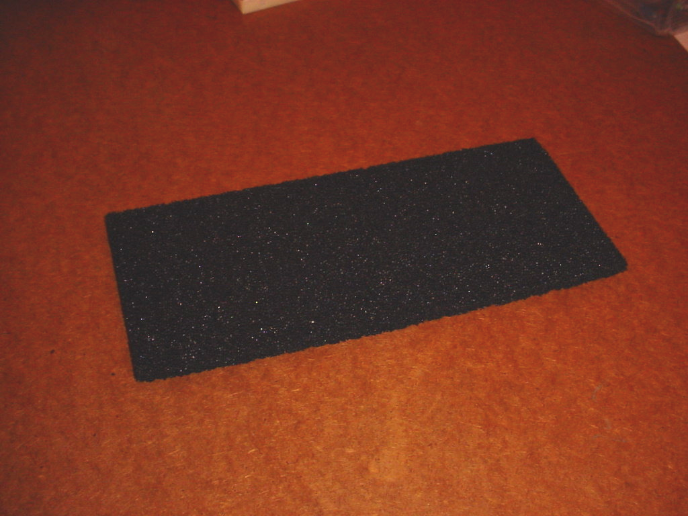
Conductive Foam

Slide 12
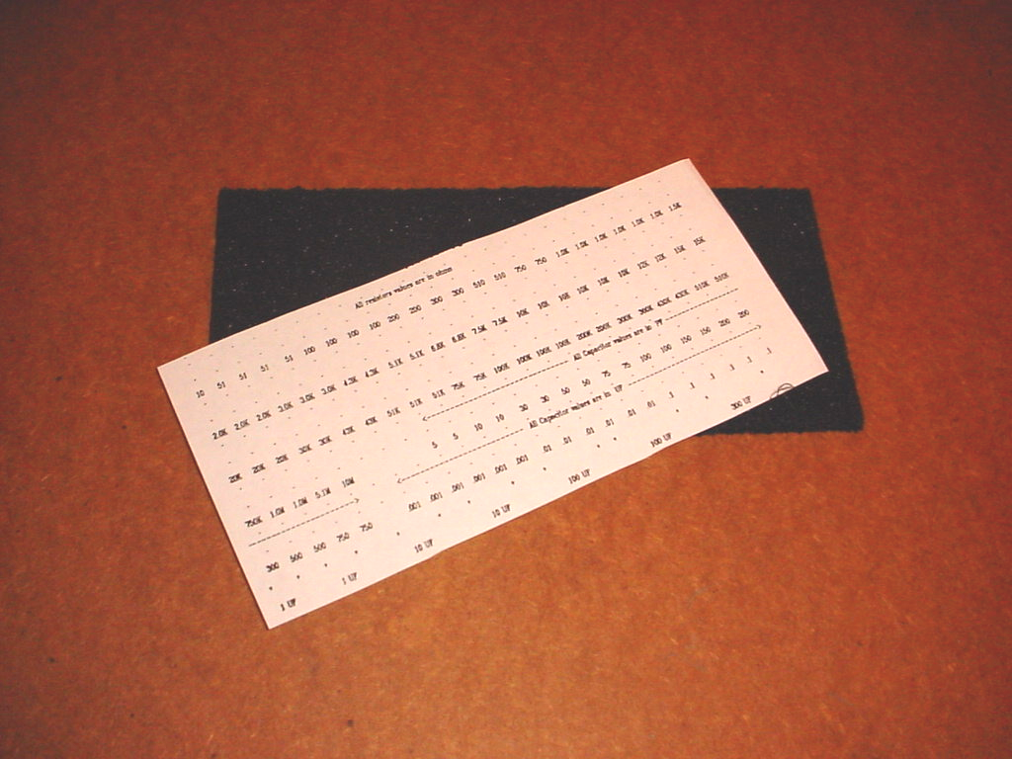
Foam and Template
(Template is Available to Print on Canvas)

Slide 13
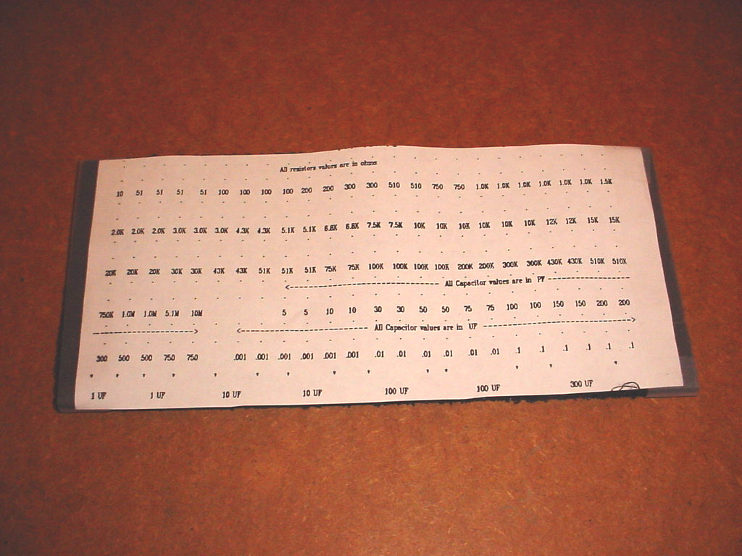
Template Applied

Slide 14
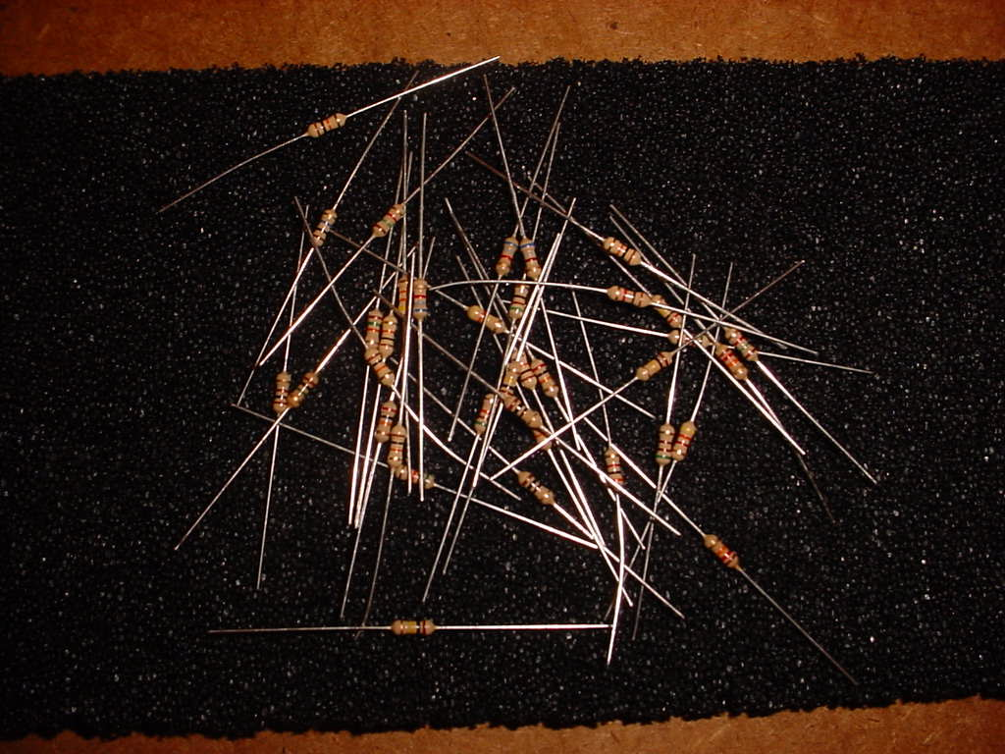
Resistors

Slide 15
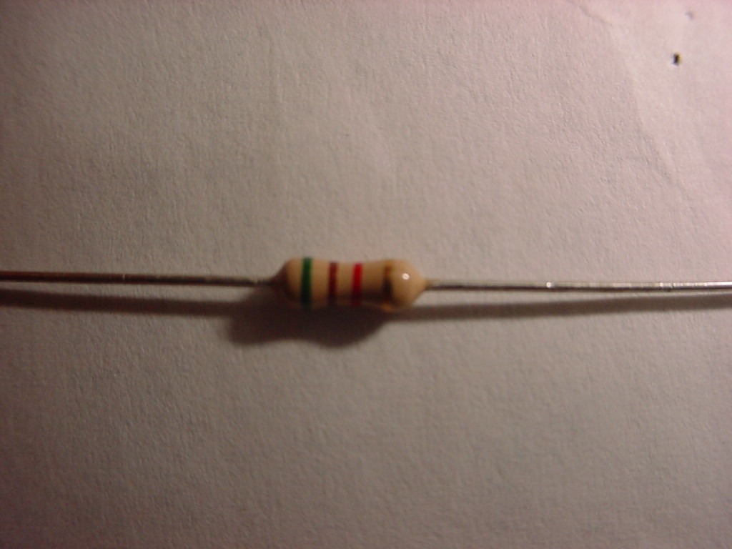
Single Resistor

Slide 16
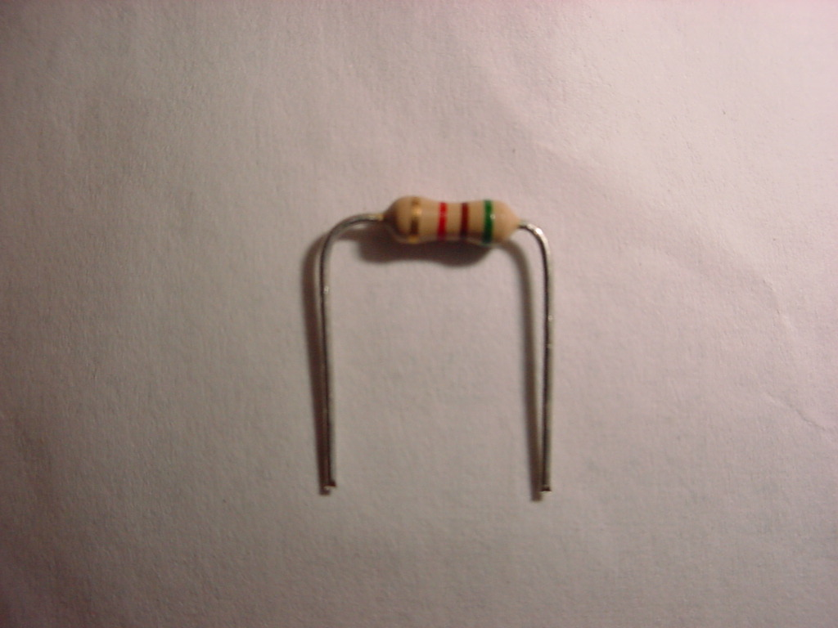
Leads Cut and Bent

Slide 17
Reading Resistor Values
Color | First Band | Second Band | Third Band
Black | N/A | 0 | ×10⁰
Brown | 1 | 1 | ×10¹
Red | 2 | 2 | ×10²
Orange | 3 | 3 | ×10³
Yellow | 4 | 4 | ×10⁴
Green | 5 | 5 | ×10⁵
Blue | 6 | 6 | ×10⁶
Violet | 7 | 7 | ×10⁷
Gray | 8 | 8 | ×10⁸
White | 9 | 9 | ×10⁹
The first two bands tell us a two-digit value (with no decimal point), and the third band tells us a multiplier. For example, if we had a resistor with blue-gray-red bands, this would mean we have 68 × 10² Ω, or 6.8 kΩ.
A fourth band gives the tolerance. A gold fourth band indicates 5% tolerance, while a silver fourth band indicates 10% tolerance.

Slide 18
Resistor Color Code Mnemonics
Each mnemonic starts at 0 and goes to 9.
A few examples:
  Bright Boys Rave Over Young Girls But Veto Getting Wed
  Better Be Right Or Your Great Big Venture Goes West
There are many others.

Slide 19
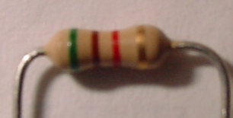
Example: Reading Resistor Values
First band is green (5)
Third band is red (×10²)
Second band is brown (1)
Fourth band is gold (5%)
Putting this together, we have 51×10² Ω (5.1 kΩ) with a tolerance of ±5%.
Tip: Start reading from the side that’s not the gold/silver band.

Slide 20
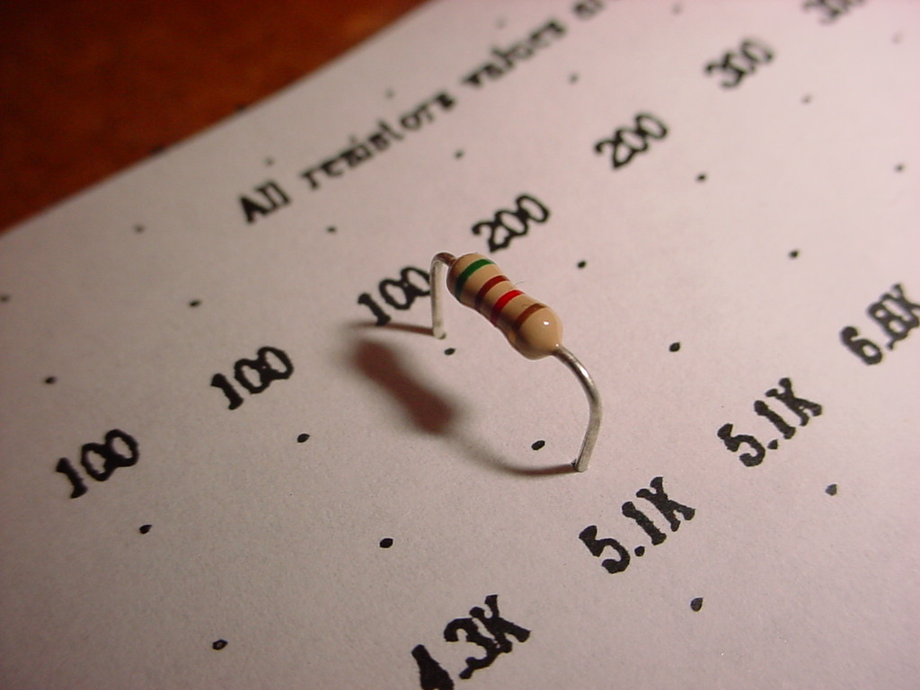
Inserted Into Template

Slide 21
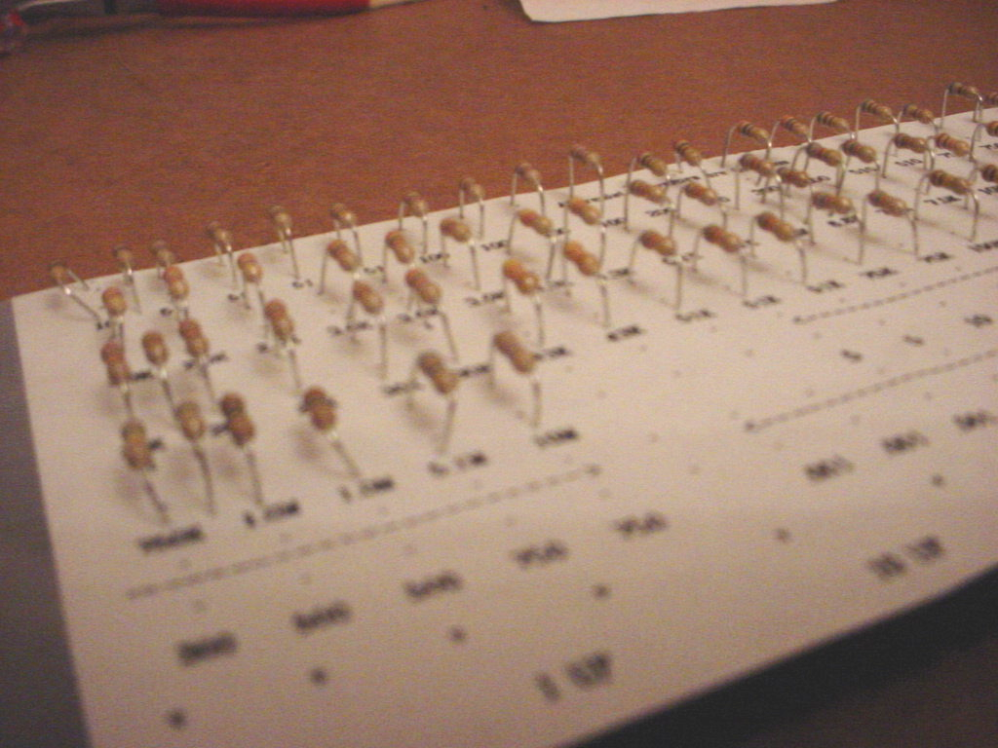
Repeated for all Resistors

Slide 22
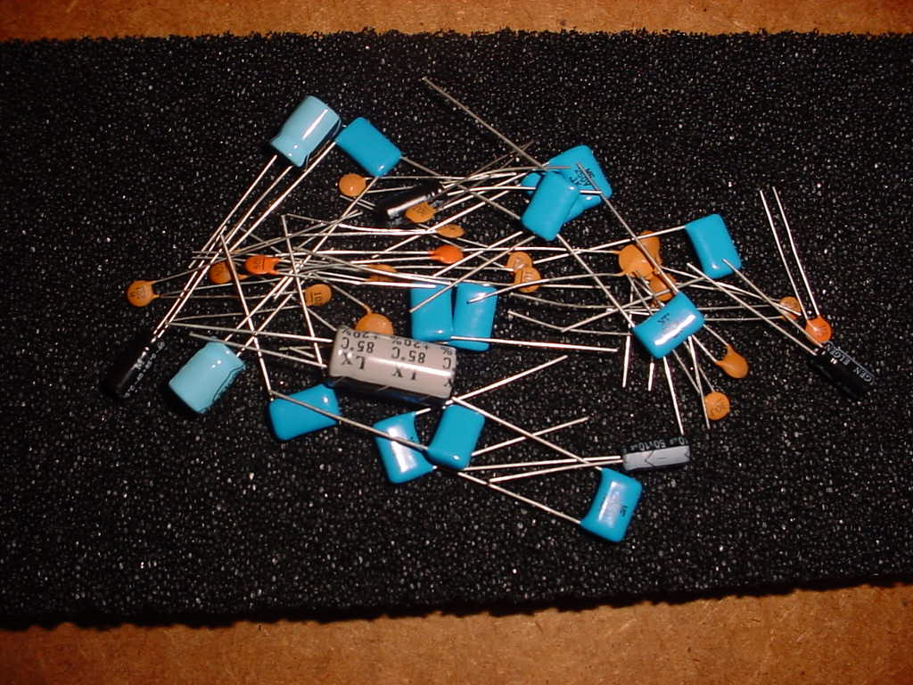
Capacitors

Slide 23
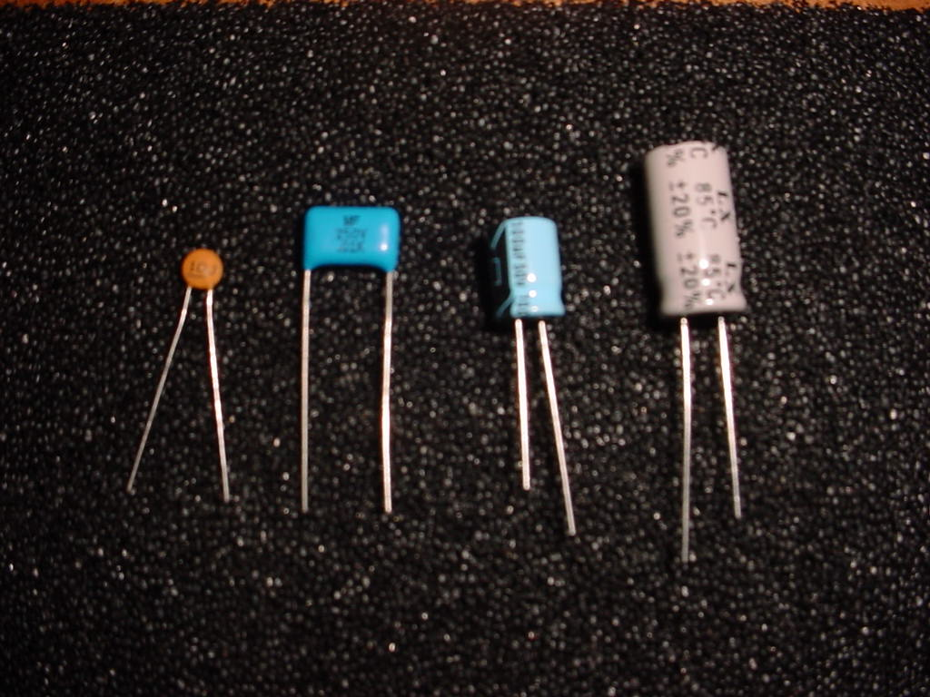
Capacitor Types

Slide 24
Reading Capacitor Values
Smaller-valued capacitors have codes similar to resistor codes, except instead of telling us the resistance in ohms, they tell us the capacitance in picofarads. We don’t have to worry about color codes here. A capacitor might be labeled something like “103K” or “2A103J” which means 10 × 10³ pF (0.01 μF). The letter “K” here is a tolerance code (and does not mean “kilo”).
Large-valued capacitors often have values indicated explicitly (e.g. 10 μF). If the capacitor has a decimal point, it should not have a full code on it (even if it has a “K” or other letter). Read these as microfarads. For example, .1K means 0.1 μF.

Slide 25
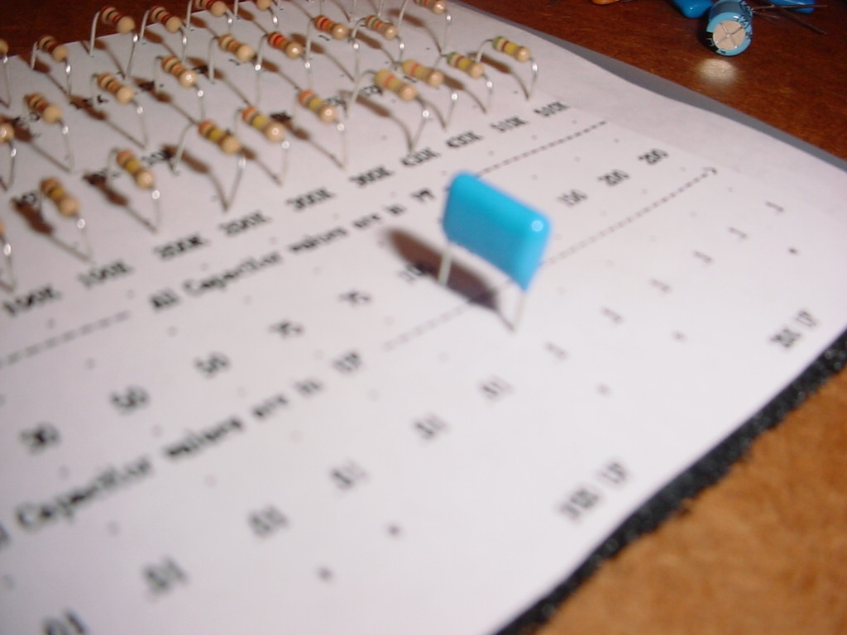
Capacitor Inserted

Slide 26
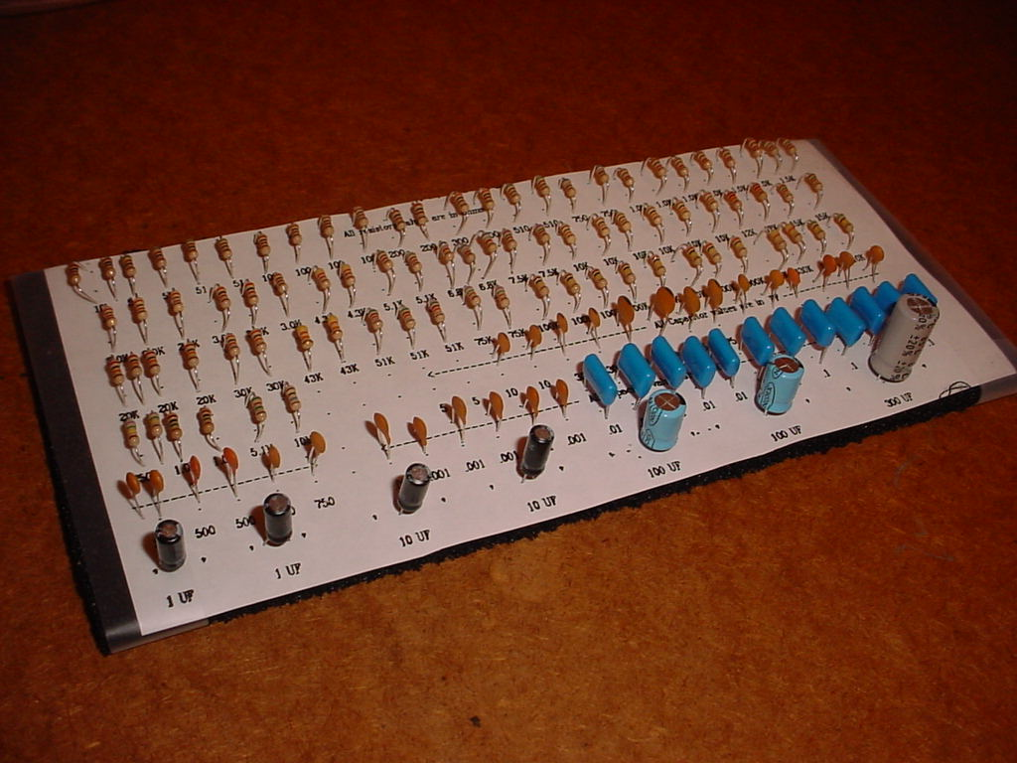
Final Product

